Slide 1
CSX4109 / ITX4109
ANDROID APPLICATION DEVELOPMENT

Slide 2
BORED OF LOCAL, LET’S GO OUT!

Slide 3
LET’S TRY
https://random.dog/woof.json

Slide 4
KTOR SETTING UP
Set Internet Permission in Manifest
Install Plugins and Dependencies
Create a Global Client with Default Configuration
CALL IT!

Slide 5
INTERNET PERMISSION
AndroidManifest.xml
<uses-permission android:name="android.permission.INTERNET" />
<uses-permission android:name="android.permission.ACCESS_NETWORK_STATE" />

Slide 6
PLUGIN
build.gradle.kts (Module: app)
id("org.jetbrains.kotlin.plugin.serialization") version “1.9.10"

Slide 7
DEPENDENCIES
build.gradle.kts (Module: app)
implementation("io.ktor:ktor-client-core:2.3.2")
implementation("io.ktor:ktor-client-android:2.3.2")
implementation("io.ktor:ktor-client-logging:2.3.2")
implementation("io.ktor:ktor-client-content-negotiation:2.3.2")
implementation(“io.ktor:ktor-serialization-kotlinx-json:2.3.2")

Slide 8
HTTP CLIENT
val httpClient = HttpClient(Android) {
install(ContentNegotiation) {
json(Json {
ignoreUnknownKeys = true
prettyPrint = true
isLenient = true
})
}
install(Logging) {
level = LogLevel.ALL
}
}

Slide 9
CALL IT!
val url = "https://random.dog/woof.json"
viewModelScope.launch {
val respondedData = httpClient.get(url) {
}.body<String>()
_response.value = respondedData
}

Slide 10
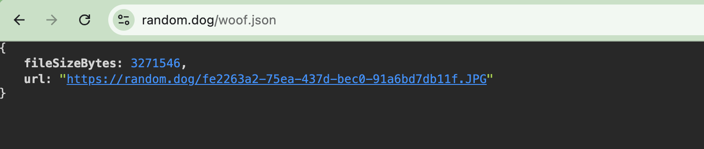
IT WORKS. BUT…

Slide 11
SERIALIZATION
@Serializable
data class RandomDogResponse (
val fileSizeBytes: Long,
val url: String
)

Slide 12
ADJUSTMENT TIME
val url = "https://random.dog/woof.json"
viewModelScope.launch {
val respondedData =httpClient.get(url).body<RandomDogResponse>()
_imageUrl.value = respondedData.url
}
Still Not Useful, huh? No Image, No Point

Slide 13
COIL FOR IMAGE LOADING
implementation("io.coil-kt.coil3:coil-compose:3.0.4")
implementation("io.coil-kt.coil3:coil-network-okhttp:3.0.4")
AsyncImage(
model = "https://example.com/image.jpg",
contentDescription = null,
)

Slide 14
EXCERCISE 1
Create an Android application to show dogs’ images from the given API path. The application must include a button to load a new dog’s image from the API when being clicked.
Method: GET
API Path: https://random.dog/woof.json
LOAD

Slide 15
LET’S EXPLORE MORE!

Slide 16
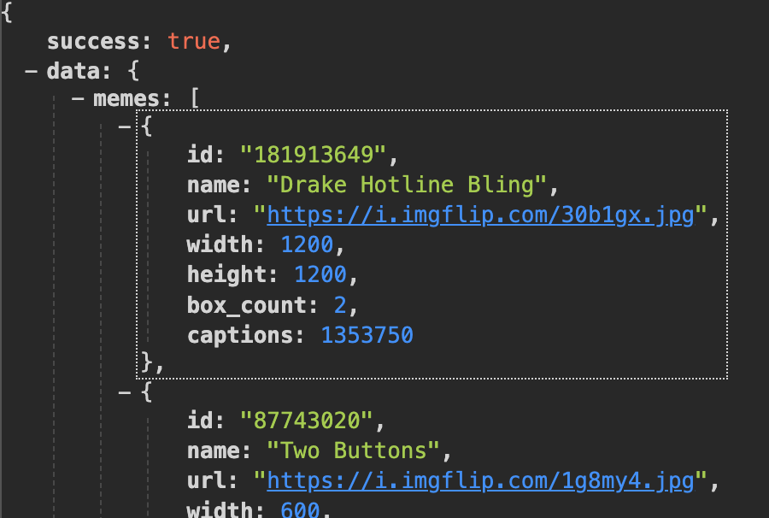
MEME LOVERS
https://api.imgflip.com/get_memes

Slide 17
HOW TO SHOW LIST?

Slide 18
LOOP IN COLUMN
Column {
for (i in 0..1000) {
Text("Index: $i")
}
}
It works! Why not?

Slide 19
LOOP IN COLUMN
Then, try this
Column {
for (i in 0..20000) {
Text("Index: $i")
}
}

Slide 20
JUST LAZY
LazyColumn - Vertically
LazyRow - Horizontally

Slide 21
USAGE
LazyColumn {
items(10000) { index ->
Text(“Index: $index”)
}
}

Slide 22
USAGE (CONT.)
LazyColumn {
items(tasks) { task ->
Text(task.name)
}
}

Slide 23
EXCERCISE 2
Create an application to show a list of memes in accordance with the design at the right hand side
Method: GET
API Path: https://api.imgflip.com/get_memes
MEME NAME #1
MEME NAME #2

Slide 24
EXCERCISE 3
Upgrade the meme list application to load the data only one time. During the next time the user launches the application again, the user can see the meme but the data will not be loaded from the API
Method: GET
API Path: https://api.imgflip.com/get_memes
MEME NAME #1
MEME NAME #2

Slide 25
CHALLENGE !!
Upgrade the meme list application to load the data only one time. During the next time the user launches the application again, the user can see the meme even if the device is not connected to the Internet
Method: GET
API Path: https://api.imgflip.com/get_memes
MEME NAME #1
MEME NAME #2

Slide 26
TERM PROJECT

Slide 27
TERM PROJECT
4 Persons per Group
40 Mark Allocation
Project Proposal - 28/12/2024

Slide 28
MANDATORY
PICK 6
PICK 4
JETPACK COMPOSE
STATELESS COMPOSABLE FUNCTION
CONFIGURATION CHANGE HANDLING
ANDROID ARCHITECTURE COMPONENT (AAC)
ROOM LIBRARY
API CALLING & CACHING
NAVIGATION
RESPONSIVE UI
BIOMETRICS (FINGERPRINT, FACE)
ANIMATION / TRANSITION
CAMERA / IMAGE PICKER
FILE PICKER
LOCALIZATION (2 LANGUAGE MINIMUM)
PLAY AUDIO / VIDEO
PAGINATION
DAY / NIGHT THEME SELECTION
APP BAR + NAVIGATION DRAWER
GOOGLE MAP INTEGRATION
NOTIFICATION WITH FCM
DEEPLINKING
BLUETOOTH INTEGRATION
UNIT + INSTRUMENTAL TESTING
MVVM PATTERN
FIREBASE FIRESTORE INTEGRATION

